Slide 1
Machine Learning Intern
Task 2
By Group(2):
Ahmed Abdulrhman
Soha Ashraf
Malak Ahmed Saber

Slide 2
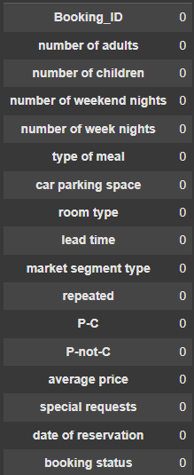
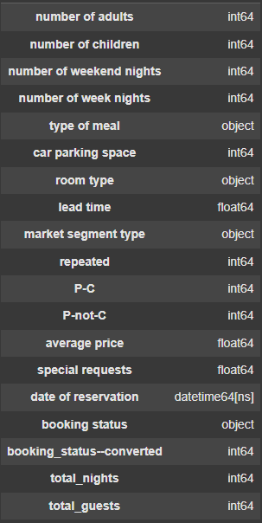
EDA + Data Processing
GOAL
Null Values:
Data Types:
Data Cleaning & Target Transformation
Target Conversion
Canceled → 1
Not_Canceled → 0
Stored in new column: Booking_Status--Converted
Data set after Data cleaning
No missing values in any column
Correct data types
Trimmed whitespaces in categorical columns

Slide 3
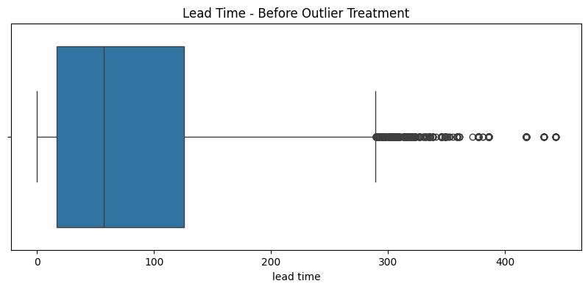
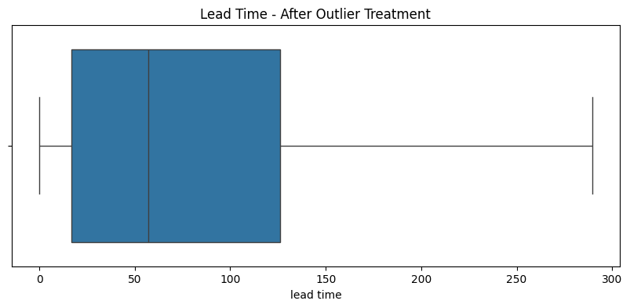
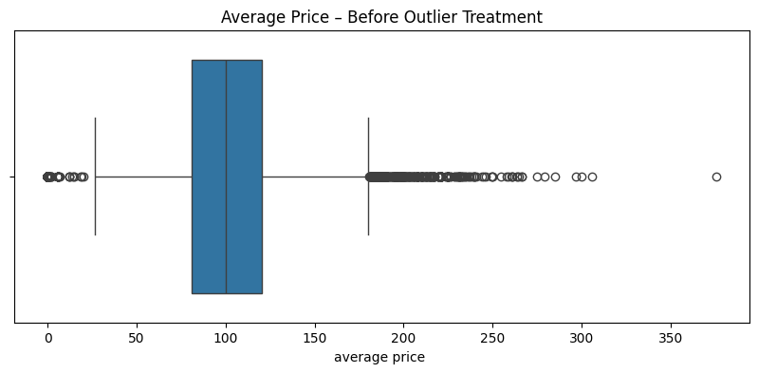
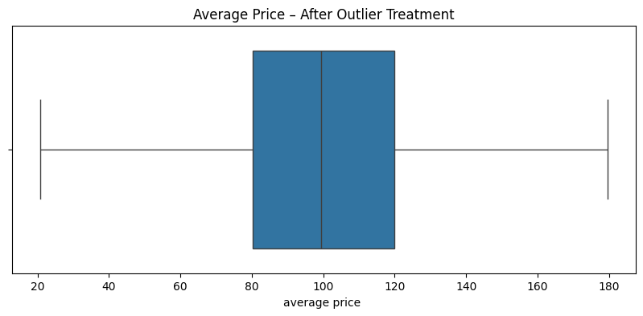
Outlier detection and treatment
Reason: Outliers can distort model training
Method: We used the IQR method to detect and clip outliers

Slide 4
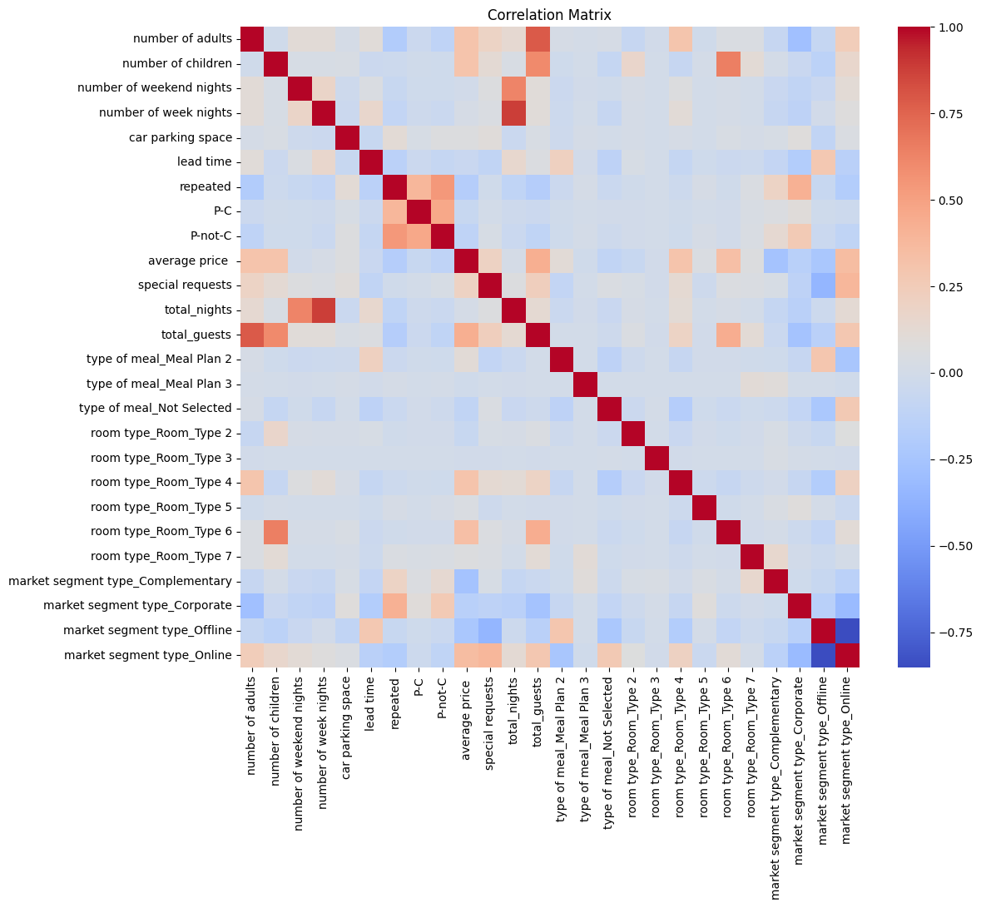
Feature Engineering
What is Feature Engineering?
Multicollinearity Handling
Creating new variables that help the model better understand the patterns in the data.
We generated a correlation matrix to check for multicollinearity
Features with high correlation (above 0.85) were removed:
Features Created
Total_nights = weekend nights + week nights
total_guests =number of adults + number of children
Multicollinearity Fix
Dropped original columns that were highly correlated with new features number of adults , number of children weekend nights, week nights.
This avoids confusion and redundant signals during training

Slide 5
Encoding Categorical Variables
Categorical Columns Encoded:
Type of meal
Room type
Market segment type
Encoding Result:
room type_Room_Type 1 = 0 or 1
type of meal_Meal Plan 2 = 0 or 1
Columns Removed:
Booking_ID
booking status replaced by numeric booking_status--converted

Slide 6
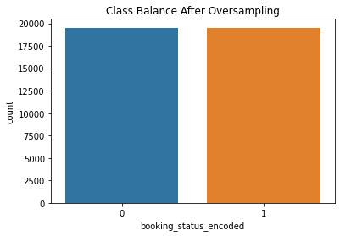
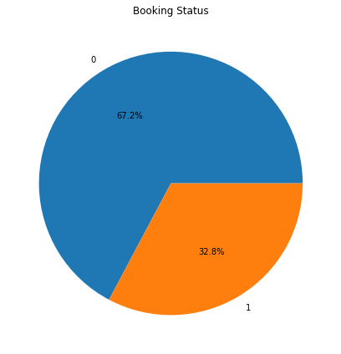
Data Imbalance
By using Oversampling, this can solve this problem.
0 : Not_Cancelled.
1 : Cancelled.

Slide 7
Classification Models Used
Models
Evaluation Metrics
Logistic Regression
Random Forest
Decision Tree
XGBoost
Polynoml Regression
Linear Regression
Accuracy
Precision
Recall
F1-Score
Confusion Matrix
MSE
R2
Train-Test Split : 80/20
Class Imbalance Handled via SMOTE and Oversampling.

Slide 8
Models performance
Logistic regression
Random forest
Accuracy : 0.85
Precision: 0.82
Recall: 0.80
F1-Score: 0.81
Accuracy : 0.88
Precision: 0.79
Recall: 0.84
F1-Score: 0.85
Decision tree
XGBOOST
Accuracy : 0.83
Precision: 0.79
Recall: 0.81
F1-Score: 0.80
Accuracy : 0.87
Precision: 0.85
Recall: 0.84
F1-Score: 0.85

Slide 9
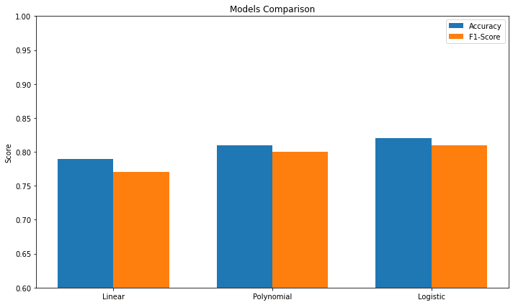
Models performance (After using Oversampling)
Linear regression
Polynomial Regression
Logistic regression
Accuracy : 0.79
Precision: 0.80
Recall: 0.79
F1-Score: 0.79
Accuracy : 0.79
Precision: 0.81
Recall: 0.79
F1-Score: 0.80
Accuracy : 0.79
Precision: 0.80
Recall: 0.79
F1-Score: 0.80

Slide 10
Final Recommendation
Random forest is the best
Gives the best overall performance across Accuracy, Precision, F1-Score, and a satisfiable Recall score
Handles non-linearity, feature interactions, and is robust to outliers.
Recommended for production deployment.
Next steps:
Hyperparameter tuning
Cross-validation
Try other models (e.g., LightGBM, SVM)

Slide 11
THANK YOU

